Slide 1
^{Bayer}
Science for a Better Life
Stéphanie DURLIN, Marie FOURCROY, Orane LISIECKI

Slide 2
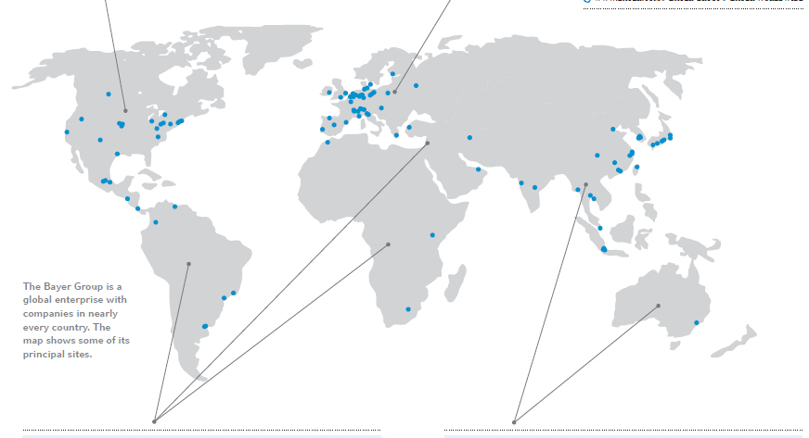
Bayer World
NORTH AMERICA
Sales | 7 705 million
Employees | 16 300
R&D expenses | 507 million
Companies | 156
EUROPE
Sales | 12 968 million
Employees | 54 500
R&D expenses | 2 080 million
Companies | 156
LATIN AMERICA / AFRICA / MIDDLE EAST
Sales | 4 783 million
Employees | 16 000
R&D expenses | 28 million
Companies | 45
ASIA/PACIFIC
Sales | 5 712million
Employees | 21 600
R&D expenses | 131 million
Companies | 57
^{E0504A}

Slide 3
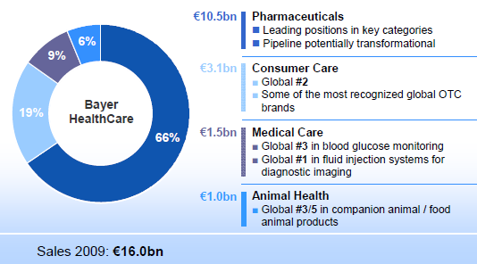
Bayer AG
Crop Protection | Environmental Science | BioScience
Herbicides | Professional products | Vegetables
Fungicides | Consumer products | Agricultural Crops
Insecticides
Seed Treatment
Polyurethanes
Polycarbonates
Coating – Adhesives – Specialties
Consumer Care | Pharmaceuticals Care
Animal Health | Diabetes care
JP Morgan 2011

Slide 4
Bayer Group Sales
31 168 million € in sales 2009

Slide 5
^{Bayer Health Care}
Science for a Better Life

Slide 6
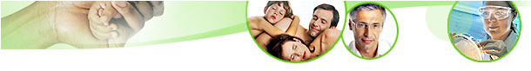
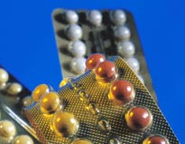

Bayer HealthCare Sales
15 988 million € in sales 2009 (+3,8%)

Slide 7
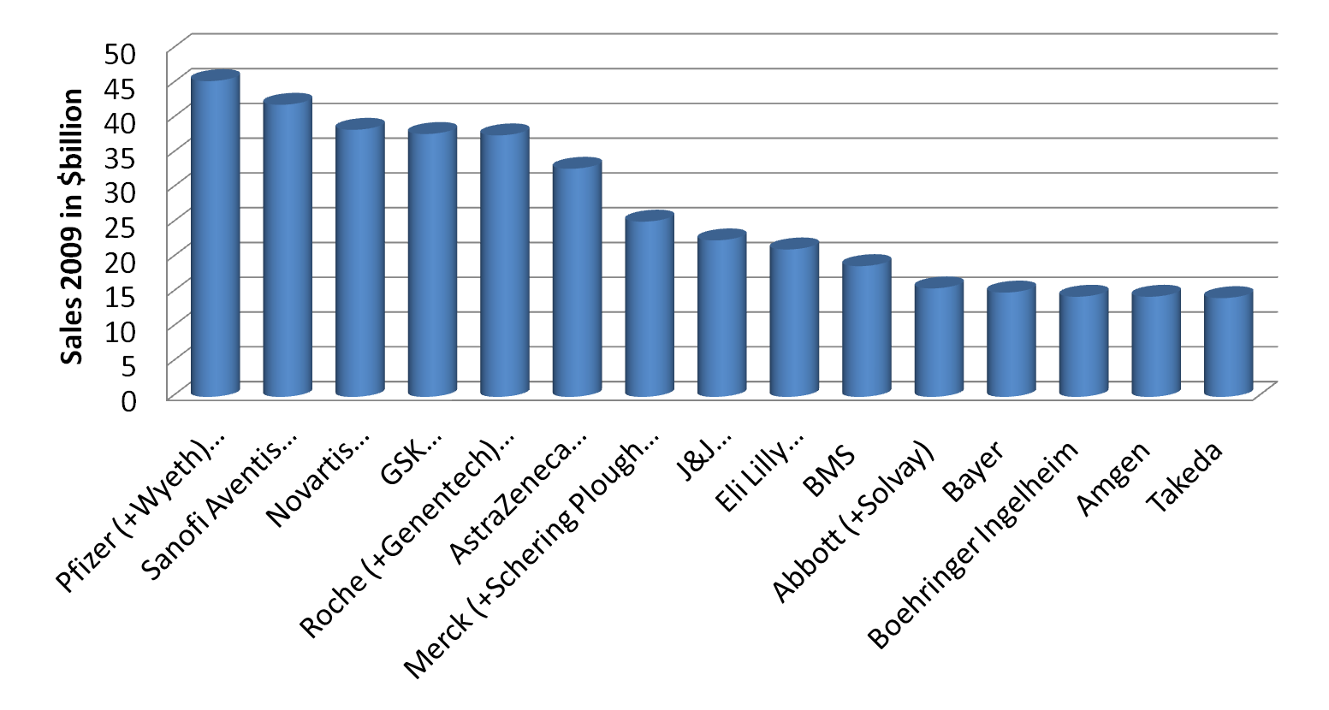
Grading of pharmaceuticals industries in 2010
JP Morgan 2011

Slide 8
A pole, four divisions
15 988 million € in sales 2009 (+3,8%)

Slide 9
^{Bayer Health Care}
^{Animal Health}

Slide 10
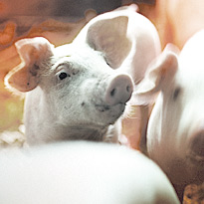
Animal Health
977 million in sales 2009 (+1,5%)
More than 100 different health and care products
4th place in vetenary medicine market
Key Products
ADVANTAGE against ticks for dogs and cats
BAYTRIL to treat infectious diseases in livestock and companion animals
DRONTAL to control endoparasites in pets
BAYCOX to control coccidia problems in farm animals
JP Morgan 2011

Slide 11
^{Bayer Health Care}
^{Diabetes} ^{Care}

Slide 12
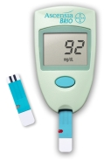
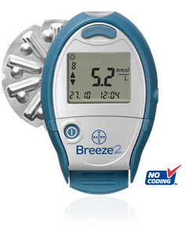
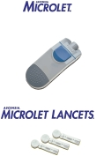
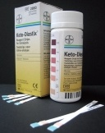
Diabetes Care
ASCENSIA
Blood glucose monitoring systems
Lancets
Individual test strips
No coding technology
MICROLET
Lancing
KETODIASTIX
Urinary bandage
A1cNow
Monitor to test glycated hemoglobin
JP Morgan
Notes:
http://www.bayerhealthcare.com/scripts/pages/en/company/corporate_profile/divisions/medical_care/index.php

Slide 13


Diabetes Care
Bayer’s CONTOUR® USB meter
A new level of diabetes management
Share with your healthcare professional
Better manage your diabetes.
Bayer’s DIDGET
Plugs into a Nintendo DS
Encourage consistent testing with reward points
Getting a meter that’s reliable.
JP Morgan
Notes:
http://www.bayerhealthcare.com/scripts/pages/en/company/corporate_profile/divisions/medical_care/index.php

Slide 14
^{Bayer Health Care}
^{History}

Slide 15
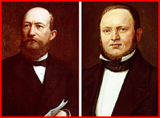
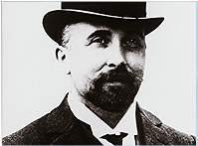
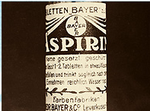
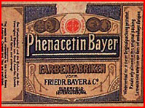
The beginning
Felix Hoffmann
Friedrich Bayer
Johann Friedrich Weskott
1863
1897
Established
Synthesinze acetylsalicylic acid
1888
1899
Antipyretic phenacetin
First product
Aspirin is registred
as a trademark
Notes:
Bayer devint part de IG Farben, un conglomérat d'industries chimiques allemandes qui émergèrent pendant la Première Guerre mondiale. Quand les Alliés démembrèrent IG Farben après la Seconde Guerre mondiale pour implication dans des crimes de guerre, Bayer réapparut en tant qu'entreprise distincte.

Slide 16
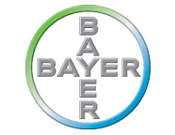
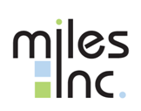
The Time of expansion
The push for expansion as an
international health care
and chemicals group began.
Bayer acquieres Cooper Technicon:
It becomes one of the largest suppliers of diagnostics systems and reagents for clinical chemistry
1972
Compagny renames Bayer AG
1978-1994
1989
Bayer acquires Miles Laboratories Inc. and
Sterling Winthrop‘s OTC to reestablishe
a presence in North America
Notes:
Miles Laboratories was founded as the Dr. Miles Medical Company in Elkhart, Indiana, in 1884 by Franklin Miles, a specialist in the treatment of eye and ear disorders, with an interest in the connection of the nervous system to overall health. Miles operated as an independent firm from 1884 until 1979 and as a wholly-owned subsidiary of Bayer AG from 1979 until 1995, when it was consolidated into the parent corporation.
reagent (Chemistry) réactif

Slide 17
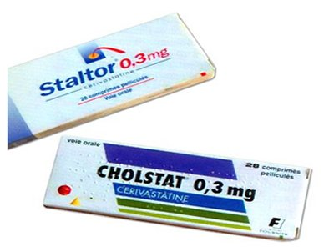
Bayer Health Care History
Cerivastatin withdrawal
2002
Notes:
In 1994, Sanofi acquired the prescription drug operations of Sterling and then it sold the diagnostic-imaging division a week later to Hafslund Nycomed AS, a Norwegian company, for US$450 million.^{[4]} Kodak then completely owned the over-the-counter drug business, including Bayer Aspirin and the U.S. rights to the Bayer name and trademarks, and sold them to SmithKline Beecham for US$1 billion, who then sold it back to Bayer AG in 1994 for US$1 billion.^{[5][6]}

Slide 18
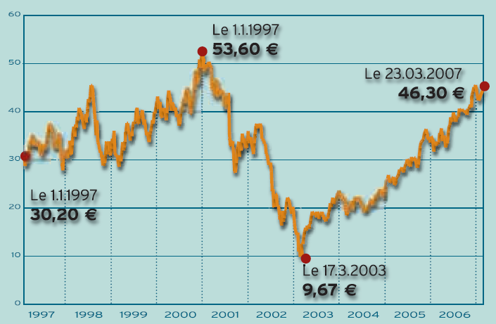
Cerivastatin Story
FDA’s approval
Indications:
Treatment of primary hypercholesterolemia and mixed dyslipidemia
Raising HDL cholesterol
EMA’s approval: Mutual Recognition
Indications:
Hyperlipidemia (0.1 – 0.4mg/day)
Post-marketing surveillance
Portugal requested that a full assessment of the risk-benefit of cerivastatin be carried out
January 2002 the EMEA received a fax from Bayer announcing that they intended to withdraw all marketing authorisations for cerivastatin
Post-marketing surveillance
52 deaths reported (rhabdomyolysis renal failure)
Risks if cerivastatin + gemfibrozil highest dose (0.8 mg/day)
Withdrawn from the market worldwide in 2002
Stock exchange
Notes:
Frequency of deadly incidents of rhabdomyolysis with cerivastatin was 16 to 80 times higher than with other statins.^{[3]} Another 385 nonfatal cases of rhabdomyolysis were reported. This put the risk of this (rare) complication at 5-10 times that of the other statins. Cerivastatin also induced myopathy in a dose-dependent manner when administrated as monotherapy, but that was revealed only after Bayer was sued and unpublished company documents were opened.

Slide 19
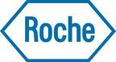
Bayer Health Care History
Acquisition Roche ‘s OTC
2004
2003
Cerivastatin withdrawal
Notes:
In 1994, Sanofi acquired the prescription drug operations of Sterling and then it sold the diagnostic-imaging division a week later to Hafslund Nycomed AS, a Norwegian company, for US$450 million.^{[4]} Kodak then completely owned the over-the-counter drug business, including Bayer Aspirin and the U.S. rights to the Bayer name and trademarks, and sold them to SmithKline Beecham for US$1 billion, who then sold it back to Bayer AG in 1994 for US$1 billion.^{[5][6]}

Slide 20
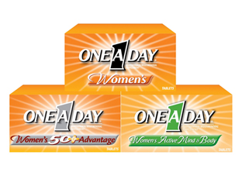
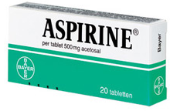
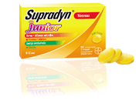
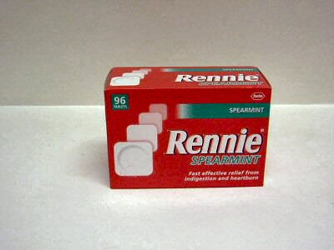
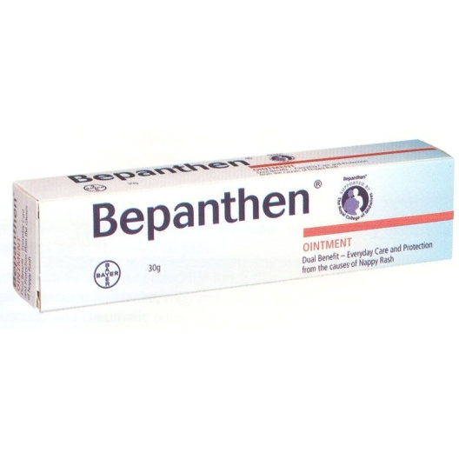
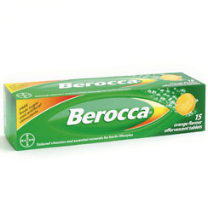
2004 : Acquisition of Roche’ OTC
3.6 billion Swiss francs = 3.7 billion Euros
Include : all assets of RCH + 5 pharmaceutical production factories
(Germany France Argentina Morocco Indonesia)
Roche sell its 50% stake in its joint venture with Bayer in the US
Analgesic, dermatological, gastrointestinal and nutritional products
Bayer’s Aspirin, Alka-Seltzer, Midol and One-A-Day
Roche’s Aleve, Bepanthen, Berocca, Flanax, Redoxon, Rennie, Supradyn
Top three non-prescription businesses worldwide
Notes:
Asset = bien

Slide 21
^{Bayer Consumer Health}

Slide 22
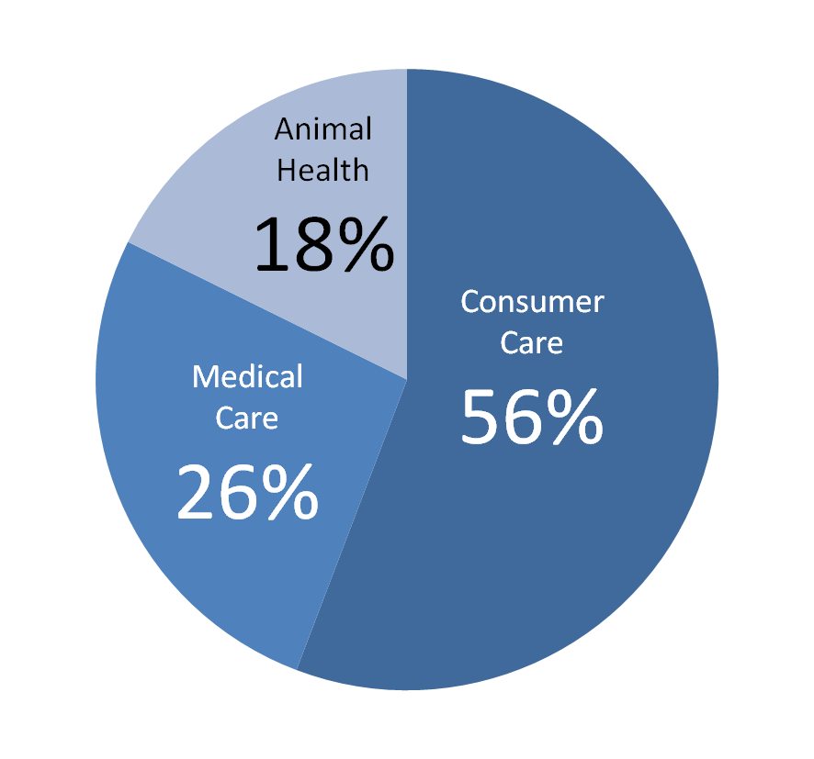
Consumer Health sales
3 divisions
5 521 million € in sales in 2009 (+2,7%)
4 434 million in sales 9M2010 (+4,3%)
801 million of EBIT 9M2010 (+11,9%)
JP Morgan 2011

Slide 23
^{Bayer Health Care}
^{Animal Health}

Slide 24
Animal Health 2010
865 million in sales 9M2010 (+4,1%)
More than 100 different health and care products
4th place in vetenary medicine market
Key Products
ADVANTAGE against ticks for dogs and cats
BAYTRIL to treat infectious diseases in livestock and companion animals
DRONTAL to control endoparasites in pets
BAYCOX to control coccidia problems in farm animals
JP Morgan 2011

Slide 25
^{Bayer Health Care}
^{Medical Care}

Slide 26
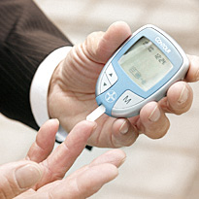
Medical care
1 464 million in sales in 2009 (+5,0%)
1 109 million in sales 9M2010 (+3,2%)
2 divisions
Diabetes Care
Medrad
JP Morgan 2011

Slide 27
Diabetes Care
ASCENSIA
Blood glucose monitoring systems
Lancets
Individual test strips
No coding technology
MICROLET
Lancing
KETODIASTIX
Urinary bandage
A1cNow
Monitor to test glycated hemoglobin
JP Morgan
Notes:
http://www.bayerhealthcare.com/scripts/pages/en/company/corporate_profile/divisions/medical_care/index.php

Slide 28
Diabetes Care
Bayer’s DIDGET
Plugs into a Nintendo DS
Encourage consistent testing with reward points
Getting a meter that’s reliable.
Bayer’s CONTOUR® USB meter
A new level of diabetes management
Share with your healthcare professional
Better manage your diabetes.
JP Morgan
Notes:
http://www.bayerhealthcare.com/scripts/pages/en/company/corporate_profile/divisions/medical_care/index.php

Slide 29
^{Bayer Health Care}
^{Consumer Care}

Slide 30
Consumer care
3 080 million in sales 2009 (+2%)
JP Morgan 2011

Slide 31
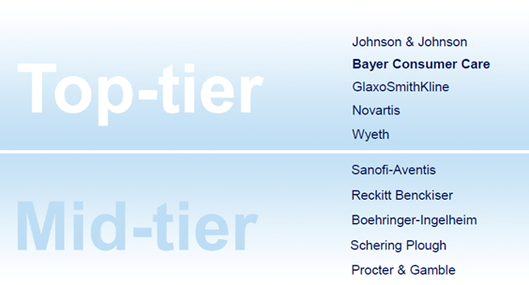
Consumer Care
3 020 million € in sales 2008
2008 Global OTC Company ranking
^{E0504A}
Bayer Consumer Care presentation for AIPM

Slide 32
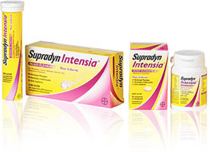
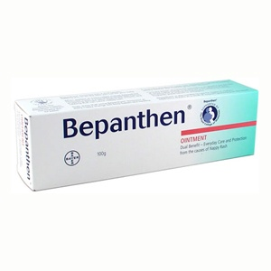
Consumer care
Well-known brand names
JP Morgan 2011

Slide 33
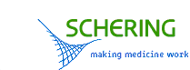
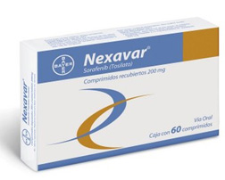
Bayer Health Care History
Acquisition of Schering AG
Acquisition Roche ‘s OTC
2004
2003
2006
Cerivastatin withdrawal
2005
Nexavar co developed with
Onyx Pharmaceuticals Inc
is approved by FDA
Notes:
Following the entry of the United States into World War II in 1941, U.S. President Franklin Delano Roosevelt ordered Schering AG's U.S. assets be seized. These became the Schering Corporation.

Slide 34
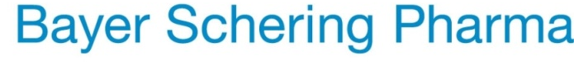
The merger Bayer – Schering AG
March 13, 2006
Merck Darmstadt announced a €14.6 bn bid for Schering AG
March 23, 2006
Merck's takeover bid was surpassed by Bayer's €16.5 bn white-knight bid for Schering
June 12, 2006
Merck KGaA disrupts takeover
June 16, 2006
Bayer finally bought the majority of shares, over 90%
Notes:
merck kgaa darmstadt
Bayer holds 61.5% of capital. If he fails to reach 75%, it may not be able to repeat an offer for a year, leaving the field open to Merck, unless the leadership of Schering accept a new offer on the spot.

Slide 35
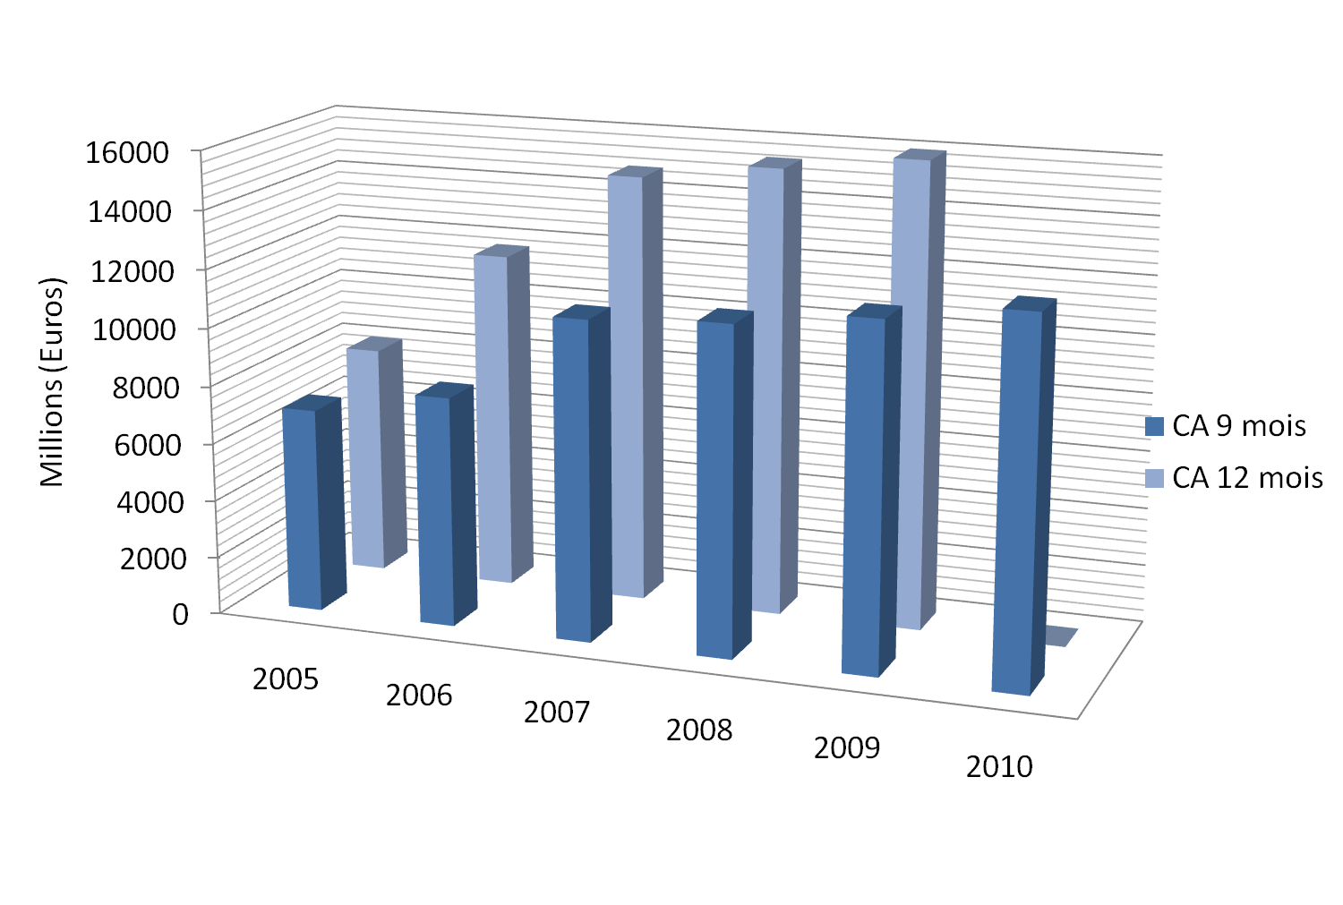
Sales Evolution
Notes:
CA 2005 = 7996
CA 2007 = 11724
Ajout vente de schering fin juin 2006
Allianz AG Holding 5.0%, flottant 95.0%

Slide 36
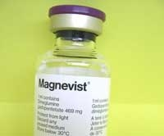
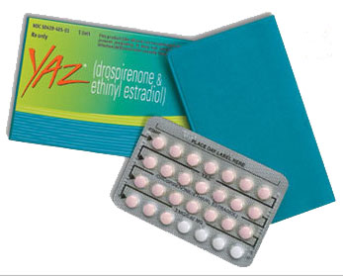
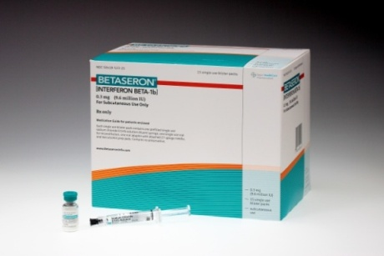
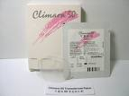
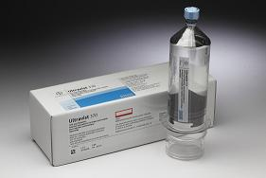
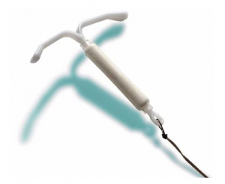
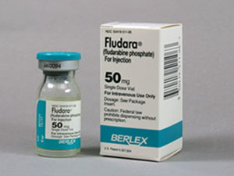
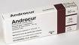
The merger Bayer – Schering AG
June 2008
General Medecine
Specialty Medecine
Women’s Healthcare
Diagnostic Imaging

Slide 37
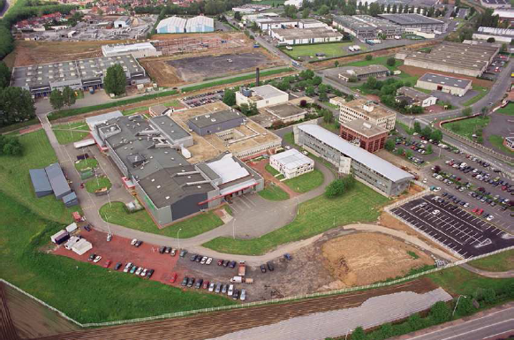
Hormone replacement therapy Scandal
Since 1970, patients and physicians were full enthousiam about hormone therapy replacement
Prevention of osteoporosis
Prevention cardiovascular disease
Prevention skin ageing
Prevention Alzheimer disease
July 2002: Women Health Initiative Study
Increasing mammary and cardiovascular risks
August 2003 Million Women Study
Increasing breast cancer risk whatever HRT
6 products were concerned
1997 : mammary risk in Lancet
1998 : HERS Study
they have doubts on cardiovascular benefits
ANGELIQ | CLIMENE
AVADENE | CLIMODIENE
CLIMARA | PROGYNOVA
AFSSAPS limited indications
Bayer Schering sold Lys lez Lannoy Production Site to Delpharm
Notes:
Frequency of deadly incidents of rhabdomyolysis with cerivastatin was 16 to 80 times higher than with other statins.^{[3]} Another 385 nonfatal cases of rhabdomyolysis were reported. This put the risk of this (rare) complication at 5-10 times that of the other statins. Cerivastatin also induced myopathy in a dose-dependent manner when administrated as monotherapy, but that was revealed only after Bayer was sued and unpublished company documents were opened.

Slide 38
^{Bayer Health Care}
^{Pharmaceuticals}

Slide 39
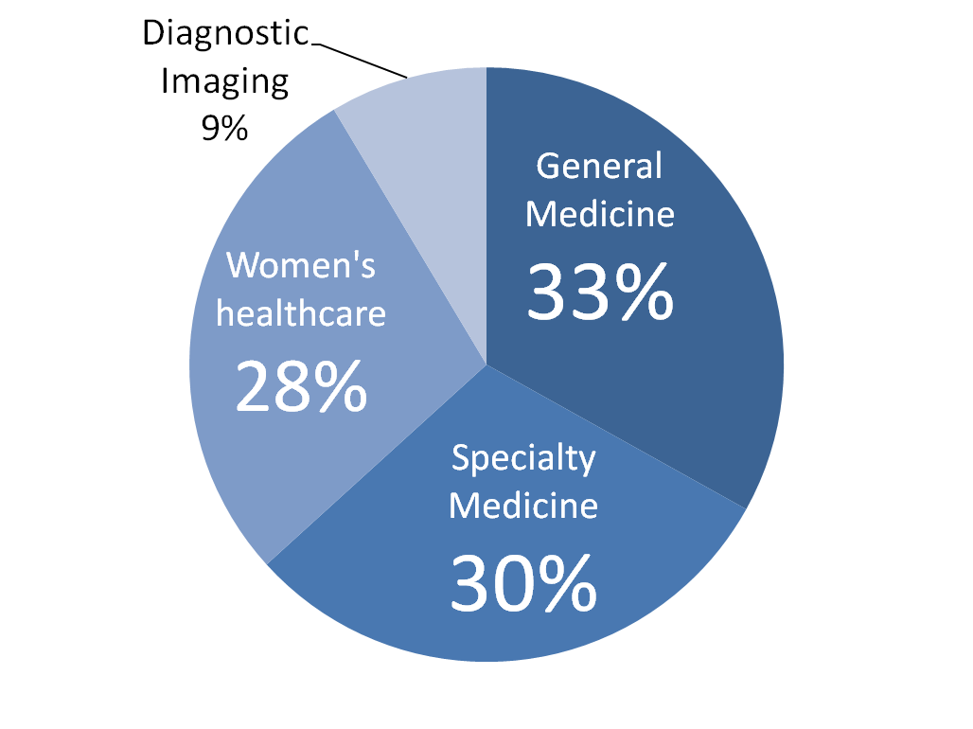
Pharmaceuticals sales in 2009
10 467 million €
in sales 2009 (+4,4%)
JP Morgan 2011

Slide 40
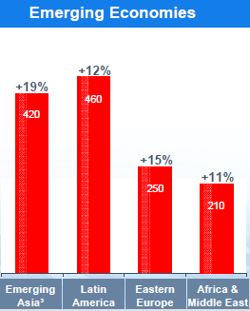
Since 2007: Life cycle management,
Inlicensing and Cooperation agreements
Acquisition OTC’s Topsun Science Tecgnology Qidong Gaitianli Pharmaceutical in China (cough and cold)
Acquisition OTC’s Sagmel Inc in Eastern Europe
Development of Medical Care Division
2007
2008
The best year
↗ 11.8% CA
↗ 21.4% EBITDA
Expansion in the pharmaceuticals market Brazil,
Mexico, South Korea, India, Turkey and Russia
Notes:
2007: Slower growth in the United States is likely to be partially offset
by more rapid growth in Europe, while expansion in the Asia-Pacifi c region in 2008 is
again expected to be buoyed primarily by China and India

Slide 41
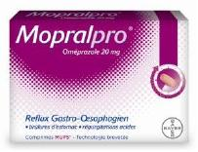
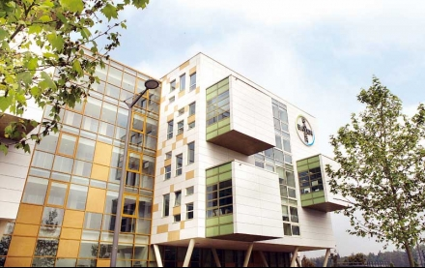
Since 2007: Life cycle management,
Inlicensing and Cooperation agreements
Continue to strengthening Consumer Health:
Licencing agrement with Astra Zeneca: marketing of OTC’s omeprazole
Continue business expansion in emerging markets
2009
April, 29 2009

Slide 42
^{Research and Development}

Slide 43
Bayer HealthCare 2009
15 988 million in sales in 2009
1 847 million in R&D
67% of all R&D expenditures by Bayer Group
17,6% of turnover
53 400 employees
3 R&D sites
JP Morgan 2011

Slide 44
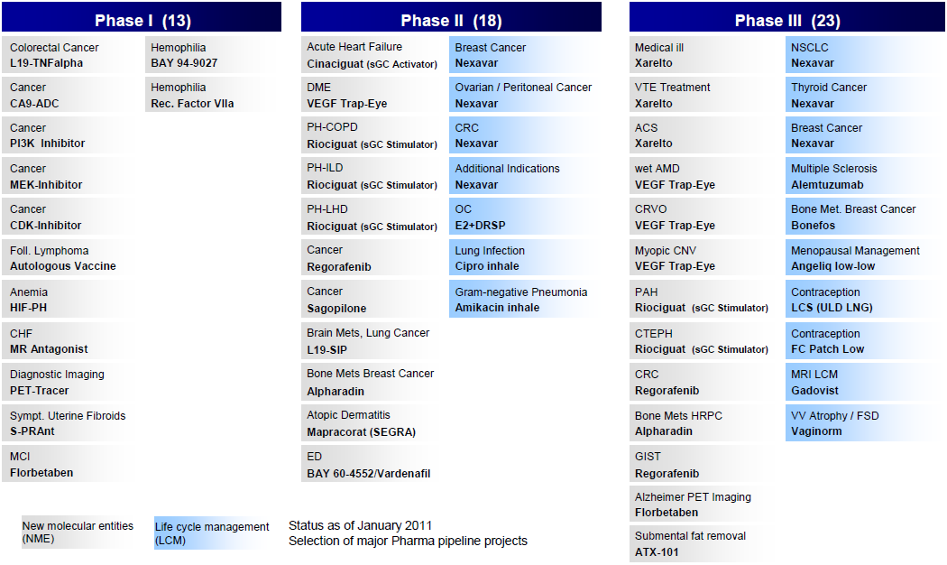
Pipeline Bayer HealthCare
^{E0504A}
JP Morgan 2011

Slide 45
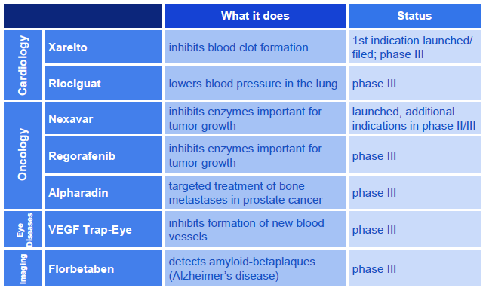
Key Pharma Pipeline Assets
^{E0504A}
JP Morgan 2011
Notes:
Consumer Care
Worldwide leader in the field of non-prescription drugs
Research and development activities of the division Consumer Care focus on the identification, development and market introduction of non-prescription (over-the-counter = OTC) products.
Our research efforts are centered around the support of existing brands and the implementation of product-related, clinical and regulatory development strategies. This offers the opportunity to successfully exploit new technologies, to expand existing product indications and to reclassify current prescription medicines as OTC products.
From Aspirin to a broad range of OTC medications
With Aspirin, the division Consumer Care possesses Bayer’s oldest healthcare product which also is one of the best known and explored pharmaceuticals woldwide. Its success story dates back more than 100 years. And research is still being continued here, too. In fact, Bayer has been bestowing the annual Aspirin Award since 1995. This award recognizes research activities that relate to the active ingredient in Aspirin, acetylsalicylic acid (ASA). Our knowledge about the versatility of this active substance is steadily increasing. Bayer is also conducting regular studies on its other products with the aim of steadily broadening its knowledge about their efficacy and tolerance. Bayer vitamin products from the One-A-Day line are especially popular in North America. This segment, too, is steadily being expanded. Our goal is to further optimize products and offer solutions tailored to the patients’ needs. It corresponds with the knowledge that self-medication is increasing in importance. The reasons for this are the cost-containment measures in the healthcare systems as well as the growing demand of patients to take health matters into their own hands. Bayer Healthcare is fully committed to this development.

Slide 46
^{Strategy}

Slide 47
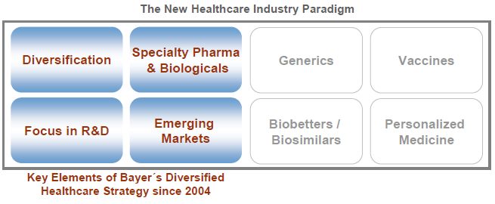
Bayer Embarked on Diversification in HealthCare LongBefore it Became the New Industry Paradigm
Back in 2004, only few of Bayer’s peers followed a diversified healthcare strategy
In 2009, this strategy is followed by almost every major pharma company
E0504A
JP Morgan 2010

Slide 48
^{Continue to Build the Pipeline}

Slide 49


Research and Development Key Pharma Pipeline Assests
E0504A
JP Morgan 2011

Slide 50


Xarelto Inhibits the Blood-clotting Process at Pivotal Stage
Anticoagulant drug : inhibits the coagulation cascade
Current treatement options have limitations :
Heparin
-> parenteral administration
Vitamin K antagonists (e.g. Warfarin)
-> narrow therapeutic window,
-> slow onset of action,
-> unpredictable pharmacology
Once-daily oral dosing
No dose adjustment for age, sex or body weight
No requirement for routine coagulation monitoring
E0504A
JP Morgan 2011
Notes:
The central role of Factor Xa
Activated Factor X (Factor Xa) is the primary site of amplification, as 1 molecule catalyses the formation of approximately 1,000 thrombin molecules.²⁵

Slide 51

Xarelto and the Market for Anticoagulants
E0504A
JP Morgan 2011

Slide 52



Nexavar
Phase I dosing-finding study in patients with CRC (n=38)
74% disease control rate in evaluable patients
Nexavar targets both the tumor cell and tumor vasculature.
It targets kinases included Raf kinase, VEGFR-1, VEGFR-2, VEGFR-3, PDGFR-B, KIT, FLT-3 and RET.
Indications:
1. Treatment of hepatocellular carcinoma. (HCC)
2. Treatment of patients with advanced renal cell carcinoma (RCC) who have failed prior interferon-alpha or interleukin-2 based therapy or are considered unsuitable for such therapy
Advancing Nexavar as a franchise-building opportunity
Several phase III studies ongoing in liver, lung, thyroid and kidney cancer
Phase III trial in breast cancer recruiting
>200 actively recruiting trials ongoing
This medicine has an "orphan designation" (used to treat no more than five in 10,000 people in the European Union)
E0504A
JP Morgan 2011
http://www.press.bayer.com/baynews/baynews.nsf/id/E308276CDC5F62FEC125771C001F6F32

Slide 53

Building Blocks of Bayer’s Oncology Pipeline
Nexavar continues to be evaluated as a single agent or combination treatment in a wide range of cancers
E0504A
JP Morgan 2011 - http://www.medicalnewstoday.com/articles/164359.php

Slide 54



Regorafenib – A new Tyrosine Kinase Inhibitor
Phase I
dosing-finding study in patients with CRC (n=38)
74% disease control rate in evaluable patients
Phase II
open –label study in kidney cancer with regorafenib (160mg) administered once daily on a three weeks on/one week off schedule (n=49)
31% partial response (RECIST)
50% stable disease rate
Phase III The CORRECT (Patients with metastatic colorectal cancer treated with regorafenib or placebo after failure of standard therapy) n=690
patients with metastatic CRC who have progressed after standard therapies.
regorafenib 160 mg plus best supportive care (BSC) vs placebo plus BSC.
Phase I dosing-finding study in patients with CRC (n=38)
74% disease control rate in evaluable patients
Regorafenib is an orally active multikinase inhibitor
(VEGF-R… : angiogenesis)
Regorafenib is ALMOST (but not quite) identical to Nexavar.
Regorafenib is a new potent oral multi-kinase inhibitor of angiogenic, stromal and oncogenic receptor tyrosine kinases. Regorafenib inhibits angiogenic kinases like receptors for VEGF and the TIE2 receptor which play a central role in angiogenesis.
Phase II, open –label study in kidney cancer with regorafenib (160mg) administered once daily on a three weeks on/one week off schedule (n=49)
31% partial response (RECIST)
50% stable disease rate
Regorafenib
Regorafenib blocks another component of angiogenesis : TIE2 which along with VEGFR also supports angiogenesis.
The Phase III Study The CORRECT (Patients with metastatic colorectal cancer treated with regorafenib or placebo after failure of standard therapy) 690 patients with metastatic CRC who have progressed after standard therapies.
regorafenib 160 mg plus best supportive care (BSC) vs placebo plus BSC.
Regorafenib works better than Nexavar in renal cell carcinoma.
Regorafenib may have additional anti-tumor targets that Nexavar doesn't have...by switching out a single hydrogen atom for a flourine atom.
February 07, 2011 : Regorafenib Receives Orphan Drug Status for the treatment of patients with gastrointestinal stromal tumors (GIST) by the FDA.
E0504A
JP Morgan 2011 - http://gistsupport.medshelf.org/Regorafenib - http://www.dddmag.com/news-Regorafenib-Receives-Orphan-Drug-Status-2711.aspx
http://messages.finance.yahoo.com/Stocks_(A_to_Z)/Stocks_O/threadview?m=tm&bn=13414&tid=52299&mid=52395&tof=10&rt=2&frt=2&off=1
Notes:
Brevet sur nexavar et 100 autres dérivés en 1999
En 2003 (2 ans avant la 1ère apporbation du Naxavar) Bayer dépose un brevet sur une molécule qu’il garde secrète
En 2005 il annonce des essais cliniques en cancéro pr un produit nommé DAST et Onyx se rend compte que c’est un fluoro-sorafenib pretégé par son brevet
Debut du procès en mai 2009
En juin 2010 Onyx en encore déposé une plainte contre Bayer pr atteinte au Nexavar

Slide 55
^{Biologicals}

Slide 56


Betaferon® - Kogenate®
Betaseron®, known as Betaferon® in Europe, was manufactured by Schering and its US associate Berlex.
It is a form of beta interferon (interferon beta, IFN-b) used to modify the course of multiple sclerosis.
Kogenate® FS is a recombinant factor VIII product indicated for the treatment of hemophilia A.
E0504A
http://www.mult-sclerosis.org/Betaseron.html - http://www.kogenatefs.com/webapp/

Slide 57

Top 10 Products Q3’2010
JP Morgan 2011

Slide 58

Research and Development Key Pharma Pipeline Assests
E0504A
JP Morgan 2011

Slide 59




VEGF Trap-Eye
VEGF Trap-Eye (Aflibercept) for the treatment of Macular Degeneration by local administration.
Phase II program with two identical studies (COPERNICUS, GALILEO, n=330) in retinal vein occlusion (CRVO)
VEGF TRAP-Eye vs sham control injection
The VEGF Trap is VEGF Trap-Eye is a recombinant fusion protein consisting of portions of human VEGF-R 1 and 2 extracellular domains, fused to the Fc portion of human IgG1
It is specifically designed to bind all forms of Vascular Endothelial Growth Factor-A (VEGF-A) and Placental Growth Factor (PLGF) proteins that are involved in the abnormal growth of new blood vessels.
COPERNICUS trial met primary endpoint :
Visual acuity change vs baseline after 6 months of treatmnt
Patients receiving VEGF Trap-Eye gained, on average, 17,3 letters of visions compared to a mean loss of 4,0 letters with sham injections
The sponsoring pharmaceutical companies, Bayer and , just reported favorable results in their own Phase III studies.
Data GALILEO trial expected in Q2 2011
E0504A
JP Morgan 2011 - http://retinaeyedoctor.com/2010/11/vegf-trap-for-macular-degeneration/ - http://www.retinalphysician.com/article.aspx?article=104951

Slide 60
^{Diagnostic Imaging}

Slide 61



Diagnostic Imaging
Detecting diseases early
Leader in MRI contrast media Ultravist® Magnevist®
Researching new procedures in molecular imaging
^{E0504A}
http://www.bayerscheringpharma.de/en/company/business_units/diagnostic_imaging/index.php
Notes:
Detecting diseases early
An early and exact diagnosis greatly influences the choice of the optimum treatment and can therefore have a positive effect on the therapeutic process. Our contrast media make it possible to take a precise look inside the human body, helping to quickly detect diseases in specific organs.
Leader in MRI contrast media
In addition to the classic X-ray procedure, various diagnostic methods are available to medicine today, such as computed tomography (CT), magnetic resonance imaging (MRI) and ultrasound. We are a global market leader in the field of in-vivo diagnostic agents with our X-ray and magnetic resonance imaging (MRI) products

Slide 62

Research and Development Key Pharma Pipeline Assests
E0504A
JP Morgan 2011

Slide 63



Florbetaben
Florbetaben is a PET Tracer for Imaging of Cerebral beta-Amyloid Plaques, a Pathological Hallmark of Alzheimer's Disease
Florbetaben is co-developed with the Swiss-based biopharmaceutical
company (in-licensed 18F-labeled)
E0504A
http://www.pharma.bayer.com/scripts/pages/en/news_room/news_room/news_room84.php
Notes:
ALZHEIMER : LE FLORBETABEN, le nouvel outil diagnostique ? Actualité publiée il y a 0h17mn Essai clinique Le potentiel diagnostique d’une nouvelle molécule dans la maladie d’Alzheimer, va faire l’objet d’un essai clinique international sur environ 400 patients, ce qui peut sembler peu pour une étude de phase 3, mais qui, pour ce type de pathologie et d'essai est probablement suffisant. Il n’existe pas d’outil sur le marché pour réaliser le diagnostic in vivo des divers types de démence, y compris celle de la maladie d’Alzheimer. Bayer Schering Pharma vient d'annoncer cet essai devant la 95e Assemblée scientifique de la Société de radiologie d’Amérique du Nord (RSNA). C’est logique, le laboratoire allemand est un leader de l’imagerie médicale mondiale (le savoir-faire de Schering) et étudie la piste de l’imagerie en vue d’un diagnostic ciblé de la maladie. La nouvelle molécule, le florbetaben, devrait être utilisée pour détecter dans le système nerveux central (SNC) les plaques de protéine bêta-amyloïde. On peut espérer en effet que cette nouvelle voie améliore les outils de diagnostic actuels, encore imparfaits. Le florbetaben (BAY 94-9172) est une molécule permettant la visualisation des plaques lors de l’utilisation d’un système d’imagerie sophistiqué : la tomographie par émission de positions (TEP), parfaitement adapté à l’examen anatomique mais aussi métabolique du SNC. Essai clinique international de phase III : Les patients enrôlés pour la phase 3 sont des sujets exprimant ou n’exprimant pas les symptômes de démence de type Alzheimer. Dans le précédent essai de phase 2 (213 patients), le florbetaben a montré sa capacité de détection des dépôts bêta-amyloïdes dans le SNC, véritables signatures pathologiques de la maladie d’Alzheimer - les résultats de cette étude ont été présentés en juillet lors de la Conférence internationale sur la maladie d’Alzheimer, permettant de discriminer (visuellement) entre sujets symptomatiques et sujets âgés non atteints… mais suspectés d’Alzheimer potentiel en raison de leur âge. C’est une avancée considérable, car « actuellement, il n’y a pas d’outil diagnostique sur le marché pour réaliser le diagnostic in vivo des divers types de démence, y compris celle de la maladie d’Alzheimer », rappelle le Dr Thomas Balzer, responsable du développement de l’imagerie de diagnostic de BayerSchering Pharma. Précisément, cet essai de phase 3 (la phase qui précède la mise sur le marché d’un procédé médical habituellement) pourrait prouver qu’il est cet outil, ce chaînon manquant, permettant peut-être un diagnostic plus précoce, et une prescription peut-être plus précoce aussi des traitements existants spécifiquement développés … mais aux performances modestes…car prescrits trop tard dans l’évolution de la maladie ? L’avenir le dira peut-être aussi… L’essai de phase 3 sera multicentrique mais non randomisé, tous les patients recevant une même unique dose, pour étude de la sécurité (confirmation) de la molécule, sa spécificité (elle ne se fixe que sur les plaques amyloïdes) et sa sensibilité (elle en permet bien le repérage). Il permettra aussi d’évaluer la quantité de flobetaben que captent les plaques amyloïdes, tout cela étant permis par la technologie d’imagerie TEP. Ce dernier paramètre, précise le laboratoire, sera évalué par des spécialistes de médecine nucléaire indépendants qui ignoreront tout des données cliniques des patients, pour aboutir à un diagnostic impartial. Les images seront comparées à des échantillons anatomiques de maladie d’Alzheimer établie par histopathologie post-mortem - le seul diagnostic de certitude dont on dispose actuellement ! Le florbetaben, dont le brevet a été déposé par BayerSchering Pharma, est un traceur administré en intraveineux (1,5 mL), qui se lie spécifiquement à la protéine bêta-amyloïde, qui s’accumule en amas, dits plaques, dans le cerveau. Le florbetaben pourrait démontrer son utilité dans le ciblage plus précis des traitements. Des résultats préliminaires sont prévus en 2011 et le résultat final en 2014. Cinq pays participent à l’étude : Etats-Unis (4 centres), Australie (1), France (1 : Lille), Allemagne (2), Japon (2). Source : BayNews, Communication BayerSchering,
Partager

Slide 64
^{Bayer in the World}

Slide 65

Bayer’s Pharma Business is Underexposed to the U.S. Market…
23% of Bayer’s global pharma sales generated in the US (2008)
The US pharma market represents ~40% of the global market
Portfolio focuses on specialty pharma and biologicals :
Oncology
Hemophilia
Women’s Healthcare
Multiple Sclerosis
E0504A
JP Morgan 2010

Slide 66

… But is a Top Tier Performer in Emerging Markets
E0504A
JP Morgan 2011

Slide 67

Leading position in Emerging markets
Bayer shows :
« Best ability to adapt to local markets »
« Superior local execution capabilities »
« A stable senior leadership team »
« Continuous investments in mature products » (Glucobay or Adalt)
E0504A
JP Morgan 2011

Slide 68

Significant Growth of Top Products in China
Glucobay and Avelox are among the top 10 selling drugs in China
E0504A
JP Morgan 2011

Slide 69
Conclusion

Slide 70
SWOT Bayer: Our opinion
Strenghts
Three differents entities
A banlanced and strong Pipeline
Specialty medicines
Separated OTC
Well-known brand names
Weaknesses
Material Science
US market
Opportunities
Biotech investment
Target population of Xarelto
Emerging markets
Threats
Risk of OPA in long term
New oral treatments for MS

Slide 71
Thanks for your attention
Stéphanie DURLIN, Marie FOURCROY, Orane LISIECKI

